Slide 1
Implementasi Struktur Data Linked List - circular
Program Studi Diploma III Teknik Informatika
Fakultas Ilmu Terapan
Universitas Telkom

Slide 2
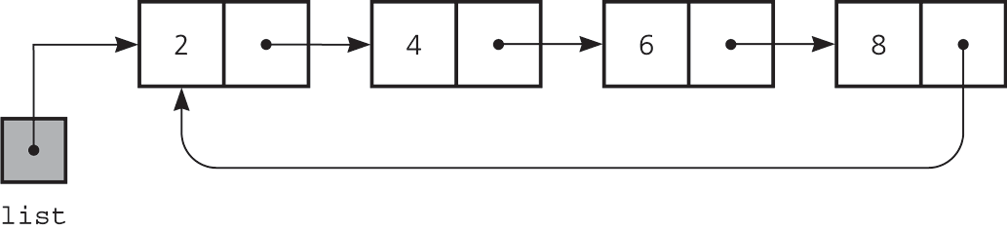
Circular Singly Linked List
Last node references to the first node
Every node has a successor
No node in a circular linked list contains NULL reference
Head

Slide 3
Circular Linked List - SISIP
Sisip Depan
Penambahan node baru akan dikaitan di node paling depan, namun pada saat pertama kali (data masih kosong), maka penambahan data dilakukan pada head nya.
Sisip Belakang
Penambahan data dilakukan di belakang, namun pada saat pertama kali data langsung ditunjuk pada head-nya.

Slide 4
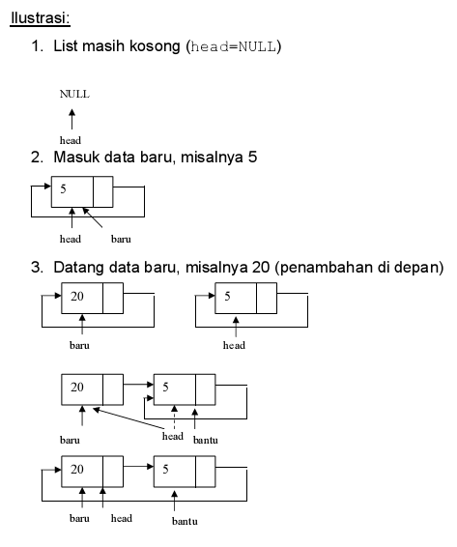
Sisip Depan – Head depan

Slide 5
Sisip Depan – Head belakang
Head
1. Masukan data baru misalnya 5.
5
next
20
next
Head
2. newNode.next menuju head
5
next
20
next
Head
5
next
20
next
3. head.next menuju newNode

Slide 6
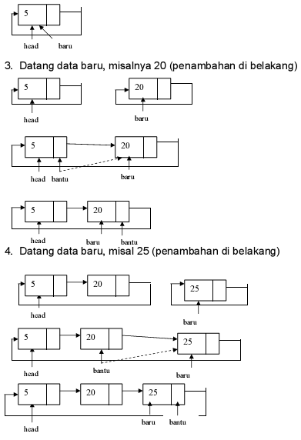
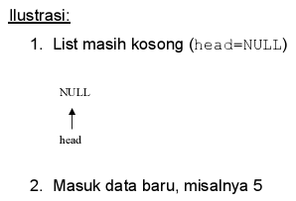
Sisip Belakang
Bagaimana dengan insert tengah?

Slide 7
Sisip belakang – Head belakang
Head
1. Masukan data baru misalnya 25.
5
next
20
next
25
next
Head
2. newNode.next menuju head.next
5
next
20
next
25
next
Head
5
next
20
next
25
next
3. head.next menuju newNode

Slide 8
Sisip belakang – Head belakang
Head
4. head = head.next
5
next
20
next
25
next

Slide 9
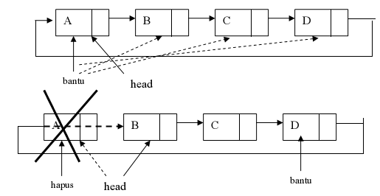
Hapus Depan – Head depan
Gunakan bantuan
Bagaimana dengan hapus tengah dan belakang?

Slide 10
Java collection

Slide 11
collection
A collection is a general term for an ADT that contains a group of objects. Some collections allow duplicate items, some do not. Some collections arrange their contents in a certain order, while others do not. A container is a class that implements a collection. Some people use the terms “container” and “collection” interchangeably.
A collection is an object that groups other objects and provides various services to its client. In particular, a typical collection enables a client to add, remove, retrieve, and query the objects it represents. Various collections exist for different purposes. Their behaviors are specified abstractly and can differ in purpose according to the collection. Thus, a collection is an abstraction and is an abstract data type. However, an ADT is not necessarily a collection.

Slide 12
Java Class Library is a collection of classes and interfaces that Java programmers use as a matter of course.
Java comes with a collection of many classes that you can use in your programs. For example, the class Math, which contains several standard mathematical methodssuch as sqrt. This collection of classes is known as the Java Class Library, and sometimes as the Java Application Programming Interface, or API. The classes in this library are organized into several standard packages.
You should become familiar with the documentation provided for the Java Class Library at
download.oracle.com/javase/7/docs/api/

Slide 13
References
Carrano, F., M., Data Structures and Abstraction with Java, 3rd Ed, Prentice Hall. (2012)
Hortsmann, C., Big Java, 4th Ed., John Waley & Sons, Inc. (2010)
Antonius Rachmat C, S.Kom, STRUKTUR DATA (7) - single linked list circular, Lecture slide

